Slide 1

Team Tagg
Sean Carroll
Max Galat

Slide 2
Contact Sharing is inefficient
~1.5 minutes for # swap on iphone
Typing in business card info takes time
It’s hard to remember
Notes:
Sam: Also do a scenario where this applies, buisness conference

Slide 3

Make interactions easier and more social
Notes:
Sam- bridge the gap between our digital and personal lives
-aides in creating a deeper more lasting connections through our propietary tagg system

Slide 4
The Meat & Potatoes
Let’s start with what our app does
Notes:
Mike

Slide 5
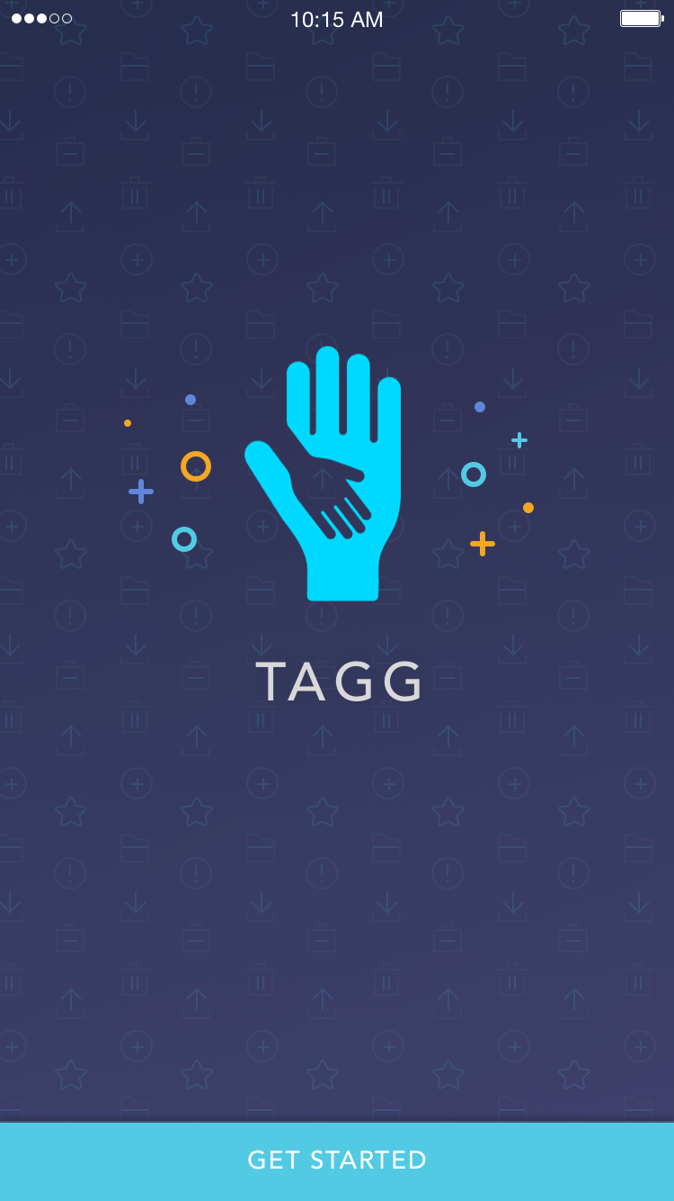
TAGG PROJECT
Seamlessly connect with people on every platform
With a touch of button
Notes:
Mike

Slide 6
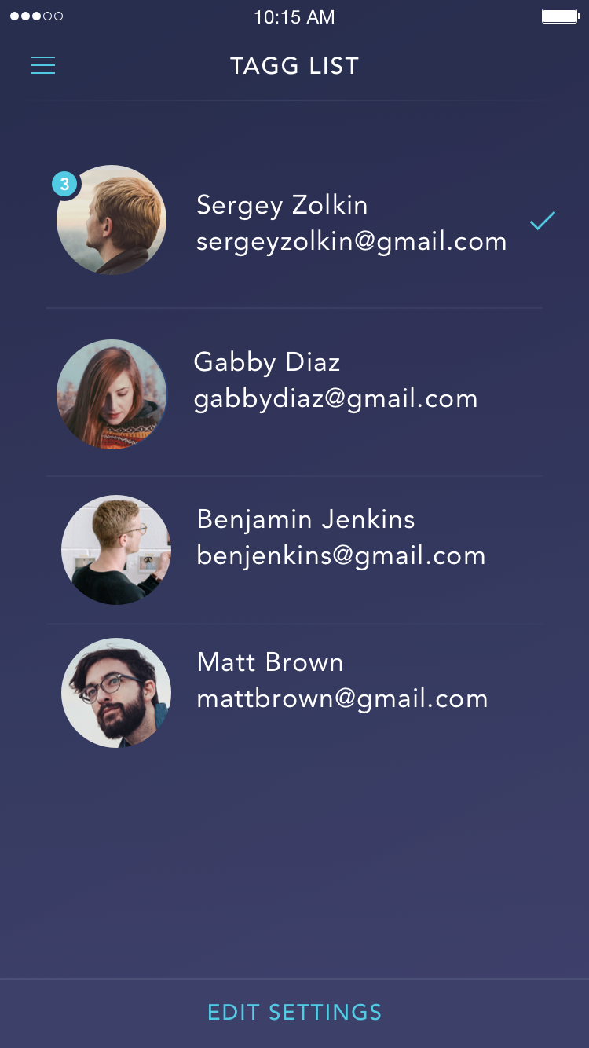
TAGG LISTS
Based on your location, Tagg will develop a list of people that you spend the most time with.
Notes:
Mike

Slide 7
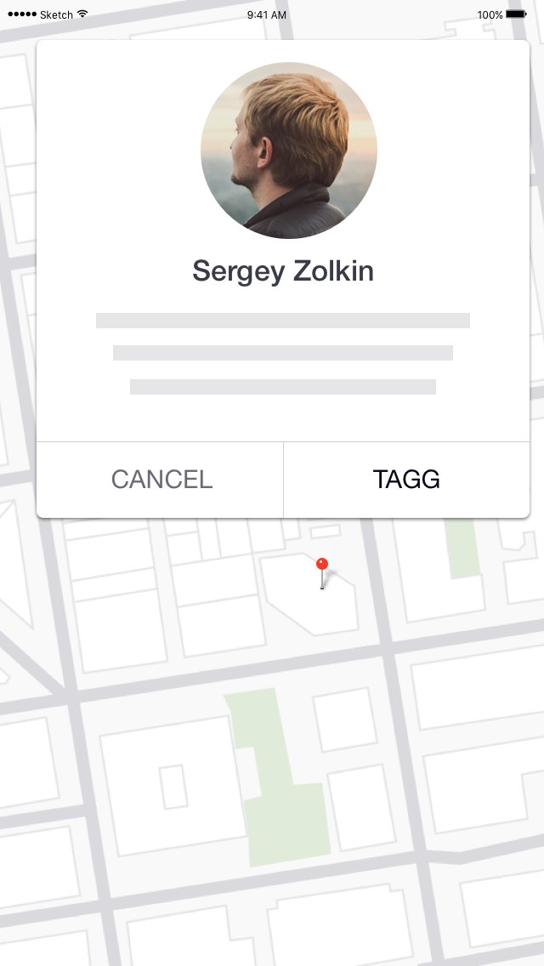
Forget Where You Met Someone?
Don’t worry, Tagg will remind you before you decide to connect.
Notes:
Mike

Slide 8
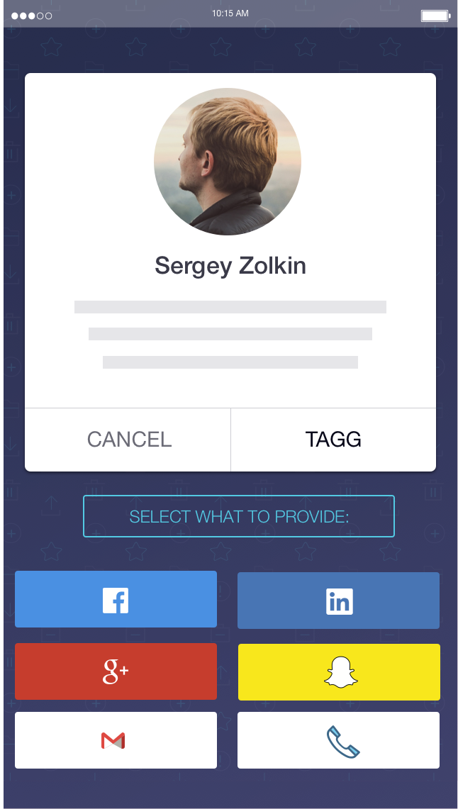
CONNECT ON ALL PLATFORMS
Choose what information you want to share
Notes:
Mike

Slide 9
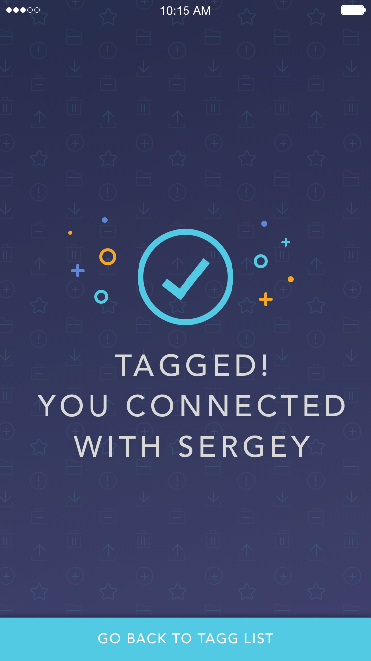
BOOM!
You’re now connected on all platforms with a touch of a button. Phone and Email too.
Notes:
Mike

Slide 10
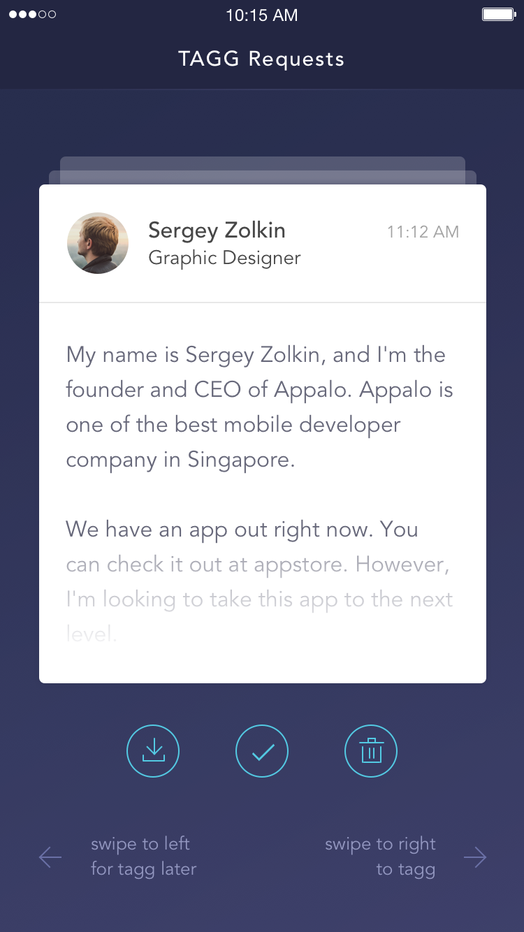
TAGG REQUESTS
Someone Tagged You. You decide what info you give them.
Notes:
Sean

Slide 11
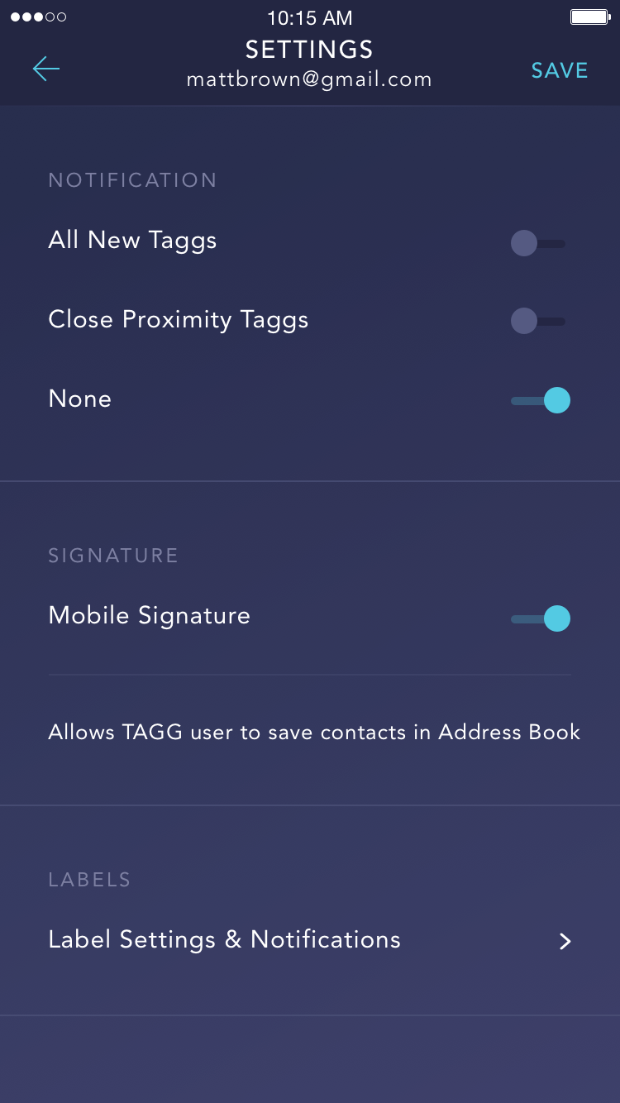
TAGG SETTINGS
Tagg is cooking up connections. Tell him how you want it.
Notes:
Sean

Slide 12
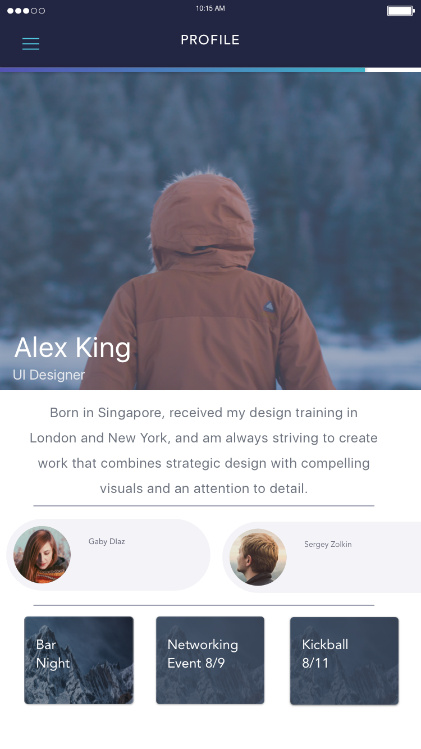
TAGG PROFILE
See your connections
Use your info from LinkedIn
Create fun Events
Notes:
Sean

Slide 13
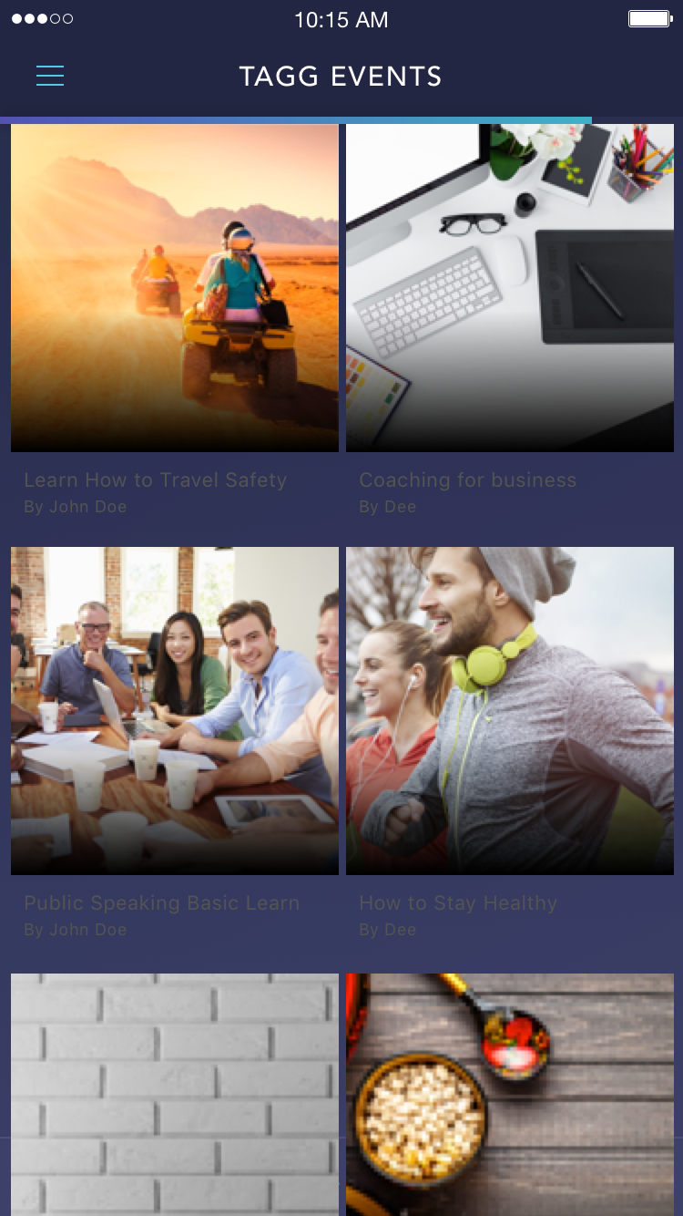
TAGG EVENTS.
Meet new connections or have fun with old.
Notes:
Sean

Slide 14
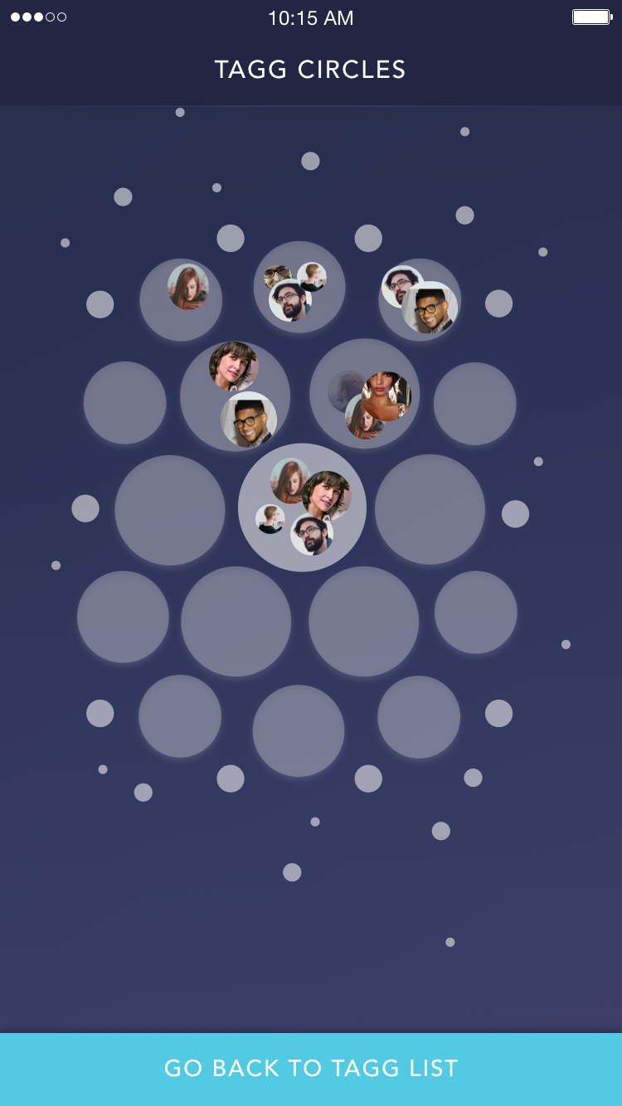
TAGG CIRCLES
You’re popular. You hang out with a lot of different people.
Tagg makes custom circles based on who you’re with and where you are.
Notes:
Sean

Slide 15
Revenue model
GPS Data
Store Optimization
Networking Events
Notes:
Sean

Slide 16
Where We’re At
Notes:
Sam

Slide 17
OUR ALGORITHM
A proprietary way to sort people based on distance and time.
Notes:
Sam

Slide 18
How we’re generating lists
John
Alex
Becky
Sergey
Notes:
Sam

Slide 19
Implementation
Firebase
Javascript
AngularJS
Java
NoSQL database
Xcode
Swift
Objective-c
CocoaPods
Google Maps API
Notes:
Sam

Slide 20
What’s Next
Notes:
Mike - Algorithm Field Testing
- Bug Fixing
- Battery Optimization
- Implementing common social media features, such as messaging, sharing content,...
- Preparing for winter release

Slide 21
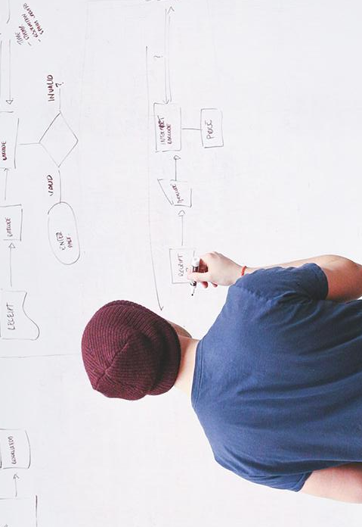
Thank you!
Any questions?
Any suggestions?

Slide 22
Credits
Special thanks to all the people who made and released these awesome resources for free:
Presentation template by SlidesCarnival
Photographs by Startupstockphotos

